Slide 1
Anticoagulation
Sister Angela Hall, Arrhythmia Nurse Specialist

Slide 2
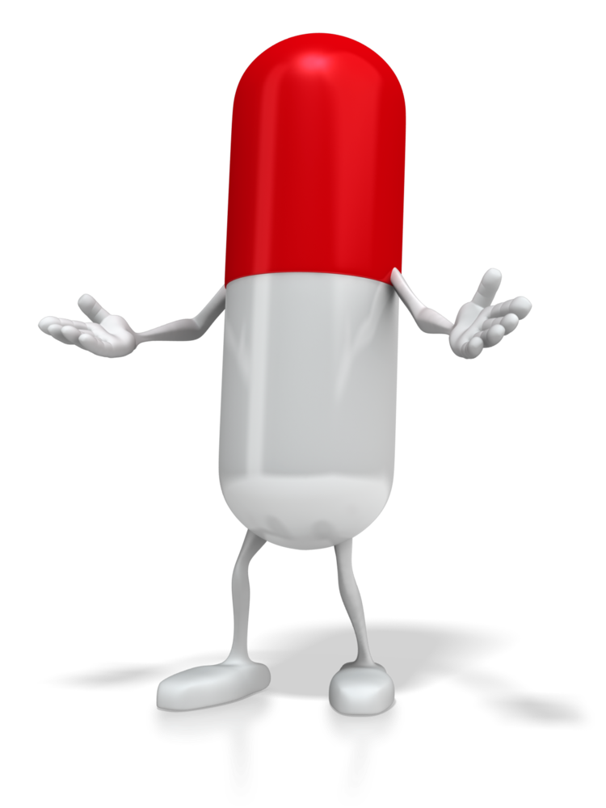
Objectives
Coagulation
Virchow’s triad of thrombogenisis
Clotting cascade
Anticoagulation indications
Anticoagulants – traditional and novel agents
Pharmacology – pharmacokinetics and pharmacodynamics

Slide 3
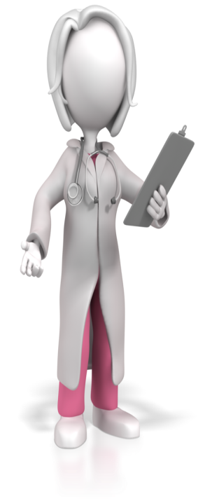
Coagulation
Coagulation is the process by which blood changes from a liquid to a gel.
It potentially results in haemostasis, the cessation of blood loss from a damaged vessel, followed by repair.
The mechanism of coagulation involves activation, adhesion, and aggregation of platelets along with deposition of fibrin.
Disorders of coagulation are disease states which can result in bleeding or obstructive clotting (thrombosis).
Notes:
The process by which blood clots, turning from a liquid to a solid
If it doesn’t work – bleeding disorders
If it works too well - thrombosis

Slide 4
Coagulation
Coagulation begins almost instantly after an injury to the blood vessel has damaged the endothelium lining the vessel.
Exposure of blood to the space under the endothelium initiates two processes:
changes in platelets, and the exposure of sub-endothelial tissue factor to plasma Factor VII, which ultimately leads to fibrin formation.
Platelets immediately form a plug at the site of injury - called primary haemostasis.
Secondary haemostasis occurs simultaneously.
Additional clotting factors beyond Factor VII respond in a complex cascade to form fibrin
strands, which strengthen the platelet plug.

Slide 5
The Role of Thrombin in Coagulation
Thrombin is the central player in thrombus formation
It is responsible for the conversion of fibrinogen to fibrin – the essential step in thrombus (clot) formation
Thrombin is the single most potent stimulus for platelet activation
Even small amounts of thrombin can initiate the up-regulation of the clotting factors which are responsible for additional thrombin production

Slide 6
The clotting cascade
Intrinsic
(contact)
  Extrinsic
(tissue factor)
Antithrombin
X
Xa
Inactivated Xa
Antithrombin
Heparin cofactor II
Prothrombin
Thrombin (IIa)
Inactivated
thrombin
Fibrinogen
Fibrin
*
.
Notes:
Clotting cascade - SIMPLE
At the site of vessel injury, platelets arrive to start sealing the wound.
At the same time, coagulation factors are activated.
2 pathways – EXTRINSIC and INTRINSIC
EXTRINSIC factors include factor 10a (Xa) and tissue factor and factor 7
Xa then forms a pathway for Extrinsic and Intrinsic pathways to meet. Difference factors then initiate others in a chain reaction.
Then forms a complex – Factor Xa which has a crucial role.
Catalyses formation of thrombin and further enhancement of platelets and enhanced formation of fibrin
The most central and essential step in the coagulation cascade is thrombin’s conversion of fibrinogen to fibrin making thrombin an attractive target for anticoagulant agents.

Slide 7
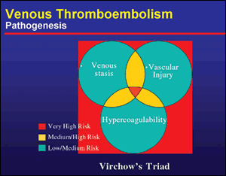
Pathogenesis of a thrombus
Virchow’s triad
Described by Rudolf Virchow
150 years ago
Postulates that vascular injury,
alterations in blood flow, and
activation of coagulation lead
to thrombus formation
Components may act independently or combine together
Joist JH. Semin Thromb Hemost. 1990;16:151-157.
Notes:
7
https://secure.pharmacytimes.com/lessons/images/200310-03/200310-03-f1.gif
It is named for German physician Rudolf Virchow (1821-1902). However, the elements comprising Virchow's triad were neither proposed by Virchow, nor did he ever suggest a triad to describe the pathogenesis of venous thrombosis. In fact, it was decades following Virchow's death before a consensus was reached proposing that thrombosis is the result of alterations in blood flow, vascular endothelial injury, or alterations in the constitution of the blood.
Hypercoaguable state can be caused by: Ca, pregnancy, surgery/trauma and sepsis
Causes of vascular wall injury are: trauma or surgery, heart valve disease and venepuncture and HYPERTENSION
Causes of circulatory stasis or turbulance are: AF, LVD, mitrial stenosis immobility and obesity

Slide 8
Virchow’s triad
Hypercoagulable state
Malignancy Pregnancy
Oestrogen therapy Sepsis
Surgery or trauma of lower organs or extremeties
Inflammatory bowel disease
Thrombophillia
Endothelial damage
Trauma / surgery
Venepuncture
Heart valve disease
Atherosclerosis
Indwelling catheters
Circulatory stasis
Atrial fibrillation
LV dysfunction
Immobility / paralysis
Venous insufficiency
Venous obstruction (from tumour, obesity, pregnancy)
Notes:
Three broad categories that contribute to thrombosis

Slide 9
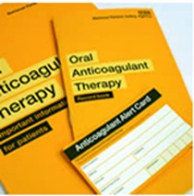
Indications for anticoagulation
Venous Thromboembolism – DVT + PE
Atrial fibrillation
Mechanical valve replacement
Ischemic stokes
Post Myocardial infarction
At least 1% of the UK population and 8% aged over 80 years old are taking Warfarin
Pirmohamed M. Br J Clinical Pharmacol 62:5, 509-511
Notes:
references
Singer DE et al .Antithrombotic therapy in atrial fibrillation. The Seventh ACCP Conference on Antithrombotic and Thrombolytic Therapy. Chest 2004;126;429S-456S

Slide 10
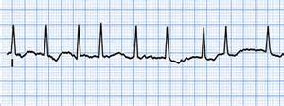
Atrial fibrillation
Atrial fibrillation is the commonest clinical arrhythmia affecting 1 in 20 at the age of 60 years and 1 in 10 at the age of 80 years
● Currently a 25% lifetime risk of developing AF
● Common cause of hospital admission and frequently complicates in-hospital surgery and
illness
● AF alone consumes 1% of all health expenditure in the UK
● AF is the most powerful independent risk factor for stroke
Notes:
How and why – chaotic activity in the atria – circulatory aspect of Virchow’s triad
Left atrial appendage

Slide 11
Incidence of AF
Index Age, yrs | Men | Women
40 | 26.0% (24.0 – 27.0) | 23.0% (21.0 – 24.0)
50 | 25.9% (23.9 – 27.0) | 23.2% (21.3 – 24.3)
60 | 25.8% (23.7 – 26.9) | 23.4% (21.4 – 24.4)
70 | 24.3% (22.1 – 25.5) | 23.0% (20.9 – 24.1)
80 | 22.7% (20.1 – 24.1) | 21.6% (19.3 – 22.7)
1 in 4 ≥40 years will develop AF
Lloyd-Jones DM, et al. Circulation. 2004 Aug 31;110(9):1042-6. Pub Med PMID: 15313941.

Slide 12
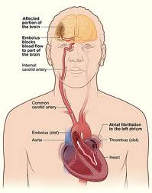
AF and strokes
If left untreated AF is a significant risk factor for stroke,
significant mortality, morbidity and reducing quality of life
Patients with AF have a five-fold increased risk of
stroke when compared to people without AF
Access to treatment can involve long waits and stroke prevention strategies can remain suboptimal
15,000 strokes and 5,500 patient deaths attributable to AF could be prevented per year if AF patients were effectively identified and treated
Strokes due to AF tend to be severe, with an increased likelihood of death and disability
The average cost per stroke due to AF is £11,900 in the first year
Notes:
More prone to blood stasis – loss of atrial kick reducing cardiac output and affects blood flow and can lead to pooling of blood in dependent areas e.g. LAA
Large number of people still not suitably anti-coagulated – common reasons (falls, anxiety, out of date evidence…)

Slide 13
CHA²DS²-VASc score
Risk Factor | Score
Congestive heart failure / LV dysfunction | 1
Hypertension | 1
Age ≥ 75 y | 2
Diabetes mellitus | 1
Stroke/TIA | 2
Vascular disease (prior myocardial infarction, peripheral artery disease or aortic plaque) | 1
Age 65-74 y | 1
Sex category (i.e. female gender) | 1
Lip GY, Nieuwlaat R, Pisters R, Lane DA, Crijns HJ (2010) Refining clinical risk stratification for predicting stroke and thromboembolism in atrial fibrillation using a novel risk factor-based approach: the euro heart survey on atrial fibrillation.
Chest. 2010 Feb;137(2):263-72.

Slide 14
Stroke or other TE event at one year
CHA2DS2-VASc | Annual Stroke Risk
0 | 0%
1 | 1.3%
2 | 2.2%
3 | 3.2%
4 | 4%
5 | 6.7%
6 | 9.8%
7 | 9.6%
8 | 6.7%
9 | 15.2%
Notes:
14
14

Slide 15
Who should receive OAC?
ESC guidelines, updated (2016)
CHA2DS2-VASc Score
0 | No antithrombotic therapy
1 | OAC (VKA or NOAC) should be considered
≥ 2 | OAC (VKA or NOAC) is recommended
Latest guidance suggests anyone with 1 risk factor should receive OAC
Notes:
15
15

Slide 16
Bleeding Risk
HAS-BLED ≥ 3, caution and regular review are appropriate as are efforts to reduce the risk of bleeding
High HAS-BLED score per se should not absolutely exclude patients from OAC
H | Hypertension | 1
A | Abnormal renal and liver function (1 point each) | 1 or 2
S | Stroke | 1
B | Bleeding | 1
L | Labile INRs | 1
E | Elderly (age >65 years) | 1
D | Drugs or alcohol (1 point each) | 1 or 2
 |  | Maximum 9 points
Notes:
16
16

Slide 17
Anticoagulate
Assess stroke risk (CHA²DS²-VASc)
Assess bleeding risk (HAS-BLED)
Risk vs benefit, clinical decision Warfarin
Consider which oral anticoagulant Dabigatran
Patient choice Rivaroxaban
Patient education Apixaban
Notes:
17
17

Slide 18
Oral anticoagulation rather than aspirin is recommended for patients with risk factors for stroke
For patients with no risk factors, no antithrombotic therapy is preferred to aspirin
www.stopstart.org.uk
STOP
ASPIRIN
Notes:
18
18

Slide 19
Evidence
Anticoagulation with warfarin or equivalent is about three times more effective at preventing AF-related stroke than aspirin
Thrombi in patients with AF are predominately fibrin-rich in contrast to coronary artery disease (platelet-rich)
Anticoagulants are more effective than antiplatelets, such as aspirin for stroke prevention in AF
Despite common perceptions aspirin is not safer than anticoagulation in terms of bleeding risk, particularly in the elderly
Over 230,000 patients with AF are currently treated with aspirin
Notes:
19
19

Slide 20
DOAC
All DOAC show non-inferiority compared to warfarin with better safety
ESC recommends DOAC as broadly preferable to VKA in non-valvular AF
Strict adherence to approved indication
Antidote to Dabigatran (Praxbind / Idarucizumab)
Compliance is crucial because they have a short half life
Assessment of renal function is mandatory for all DOAC’s, assessed annually with normal renal function and 2-3 times a year with renal impairment
DC cardioversion can be safely done on DOACs
Notes:
20
20

Slide 21
How they work
  All anticoagulants exert their effects by directly or indirectly inhibiting thrombin through either:
  Reducing thrombin production
  and/or
  Inhibiting thrombin activity
  Vitamin K antagonists, LMWH and UFH impair thrombin generation or indirectly inhibit thrombin activity
  Blocking thrombin production is achieved by inhibiting other coagulation factors such as:
    Factor Xa
    Factor IXa
    Factor VIIa/tissue factor complex
Weitz JI. Chest. 2001;119(1 Suppl):95S-107S
Notes:
Given the central role of thrombin, all anticoagulants exert their effects by directly or
indirectly inhibiting thrombin through either:
By reducing thrombin production
By inhibiting thrombin activity (either indirectly or directly)
Unfractionated heparin (UFH) and to a lesser degree low molecular weight heparin
(LMWH) indirectly inhibit thrombin through an intermediary known as antithrombin.
All of the approaches listed above can be considered to indirectly inhibit thrombin
(including thrombin’s other associated factors).
Direct thrombin inhibitor – Dabigatran
Blocking thrombin production - Direct Xa inhibitor – Riv / Apixaban

Slide 22
The clotting cascade
Intrinsic
(contact)
  Extrinsic
(tissue factor)
Antithrombin
Indirect
Factor Xa inhibitors
Heparin/LMWH
X
Xa
Inactivated Xa
Antithrombin
Heparin cofactor II
Warfarin*
Prothrombin
Thrombin (IIa)
Inactivated
thrombin
Fibrinogen
Fibrin
*
.
Notes:
This slide highlights where each of the different anticoagulants work in the coagulation
cascade.
The most central and essential step in the coagulation cascade is thrombin’s conversion
of fibrinogen to fibrin making thrombin an attractive target for anticoagulant agents.
Dabigatran etexilate is a direct, reversible thrombin inhibitor which directly blocks both
free and clot-bound thrombin, to prevent thrombus formation.
It binds directly to thrombin and blocks its effects upon its substrates
Direct thrombin inhibitors (DTIs) target thrombin with a high degree of specificity, which
unlike other anticoagulants, means the action of DTIs are limited to thrombin
Direct thrombin inhibitors block the procoagulant effects of thrombin including,
Thrombin’s conversion of fibrinogen to fibrin
Thrombin’s platelet activation
Thrombin’s up regulation of clotting factors V, VIII and XI which play an important role in the amplification of thrombin production
Reversible binding to the active site of thrombin permits a linear dose-effect relationship
for the onset and offset of anticoagulant effect.
Warfarin reduces the quantity of proteins that allow the blood to clot
- reduces fibrin production by upsetting things further up the cascade
- does this by inhibiting vitamin K enzyme

Slide 23

Story of Warfarin
1930’s American farmer named Ed Carlson found his cattle had a mysterious
haemorrhagic disease
Cattle vomited up blood that did not clot
Herd fed spoilt sweet clover
Desperately he loaded up his truck with a dead heifer
He drove 190 miles to the University of Wisconsin
After investigations by Karl Paul Link – toxic components in clover identified as
Dicoumarol
Hence Warfarin name obtained from: Wisconsin, Alumni, Research, Foundation (1)
It was Initially developed for Rodent control but after an attempted suicide by a US
army recruit in 1951 it’s affects on humans were then discovered (2)
1 Oral anticoagulation management and stroke prevention Fitzmaurice & ET Murray 2009
2 Bryan J Why warfarin was an important step forward in anticoagulation therapy; The Pharmaceutical journal 2010: 284, 189-190

Slide 24
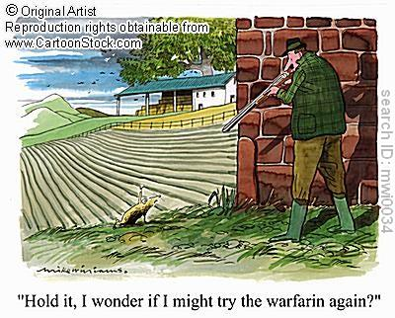

Slide 25

Benefits of warfarin
2/3 of strokes due to AF are preventable with appropriate anticoagulant therapy with a vitamin-K-antagonist (INR 2-3)¹
Anticoagulation with a vitamin-K-antagonist (VKA) is recommended for patients with more than 1 moderate risk factor²
A meta-analysis of 29 trials in 28,044 patients showed that adjusted-dose warfarin results in a reduction in ischaemic stroke and in all-cause mortality¹
Stroke
Death
67%
26%
1. Hart RG et al. Ann Intern Med. 2007;146:857-867 2. Fuster V, et al. JACC. 2006; 48: 854-906
Notes:
Thankfully it’s not all doom and gloom – as we know we’ve got Warfarin – which in the AF population is a highly efficacious anticoagulant.
It confers a 67% risk reduction of stroke in AF and also over a 25% risk reduction of all cause mortality.
Since the late 70’s early 80’s we’ve got large randomised clinical trials looking at anticoagulation with Warfarin in the AF population - So what we can say, with some confidence, is Warfarin should definitely be advocated as an anticoagulant in this population
25

Slide 26

Contraindications - interactions with warfarin
History of bleeding
Liver Disease
Renal Failure
Alcoholism
Cognitive impairment
Hx of thrombocytopenia
Coagulation disorders
Other medications
Should be listed as CAUTIONS as only absolute contraindication is haemorrhagic stroke, significant bleeding and 48 hours postpartum
Likely this contributes to reluctance with OAC when really benefit outweighs the risk
CAUTIONS – stop 5 days pre-op (bridging), severe hepatic impairment, monitor INR more frequently in renal impairment, first trimester of pregnancy, history of GI bleeding, recent surgery, recent ischaemic stroke, uncontrolled hypertension, concomitant use of drugs that increase bleeding
MHRA PUBLIC ASSESSMENT REPORT Warfarin: changes to product safety information December 2009;1-19
Notes:
Other medications - >250 medicines which report caution when used in combination. E.g. Amiodarone / Statins / Thyroxine but generally this is not a contraindication – just need to monitor the INR more frequently
Dual anti-platelet and warfarin – not ideal and limit the time required. Anti platelet usually for 1 year post MI / PCI but if AF occurs, add OAC and omit Aspirin on specialist advice
Highly protein bound drugs can displace warfarin and elevate the INR
Some drugs can reduce the metabolism of warfarin e.g. metronidazole
Thyroid – hypothyroid = people less responsive to warfarin treatment
hyperthroid = boosts the anticoagulant effect
Watch foods / alcohol containing vitamin K

Slide 27
Limitations of Warfarin Therapy
Unpredictable response
Frequent dose adjustments
VKA therapy has several limitations that make it difficult to use in practice
Narrow therapeutic window
(INR range 2-3)
Numerous food-drug interactions
Routine coagulation monitoring
Numerous drug-drug interactions
Slow onset/offset of action
Warfarin resistance
Ansell J, et al. Chest 2008;133;160S-198S; 2. Umer Ushman MH, et al. J Interv Card Electrophysiol 2008; 22:129-137; Nutescu EA, et al. Cardiol Clin 2008; 26:169-187.
Notes:
As we all know Warfarin has a few other difficulties which makes it quite hard to use, perhaps, especially in the elderly population with poly-medication
Routine anticoagulation monitoring required; lots of drug (antibiotics, antipsychotics, paracetamol) and food interactions; narrow therapeutic window; slow onset and offset of action – which is a problem when you have to load or ’bridge’
Also, certainly in the UK, there is a picture where if you have approximately 100 patients with AF who are advocated for anticoagulation, only 50% of those patients actually are; and as we know of those 50% of patients who do get Warfarin, only perhaps 25% of them are adequately monitored within time in range. So of your 100 patients that you’ve identified with AF, who should be protected via good anti-coagulation only around 25 are

Slide 28
Narrow therapeutic range with VKA
Target INR
(2.0-3.0)
20
15
Stroke
10
Intracranial bleed
Odds ratio
5
1
0
1
2
3
4
5
6
7
8
International Normalized Ratio (INR)
Fuster
V et al. Circulation 2006;114:e257
–
e354
6
Notes:
28
The anticoagulant effect of VKAs are optimized when therapeutic doses are maintained within a very narrow range.
Over-anticoagulation (INR >3) can lead to an increased risk of bleeding and under-anticoagulation (INR <2) can lead to increased risk of stroke.
Therapeutic index – ratio of a drug that causes a lethal effect and dosage that causes a therapeutic effect
Toxic vs therapeutic effect
TTR – estimated to be <60% in warfarin patients and if so – consider swapping to NOAC

Slide 29
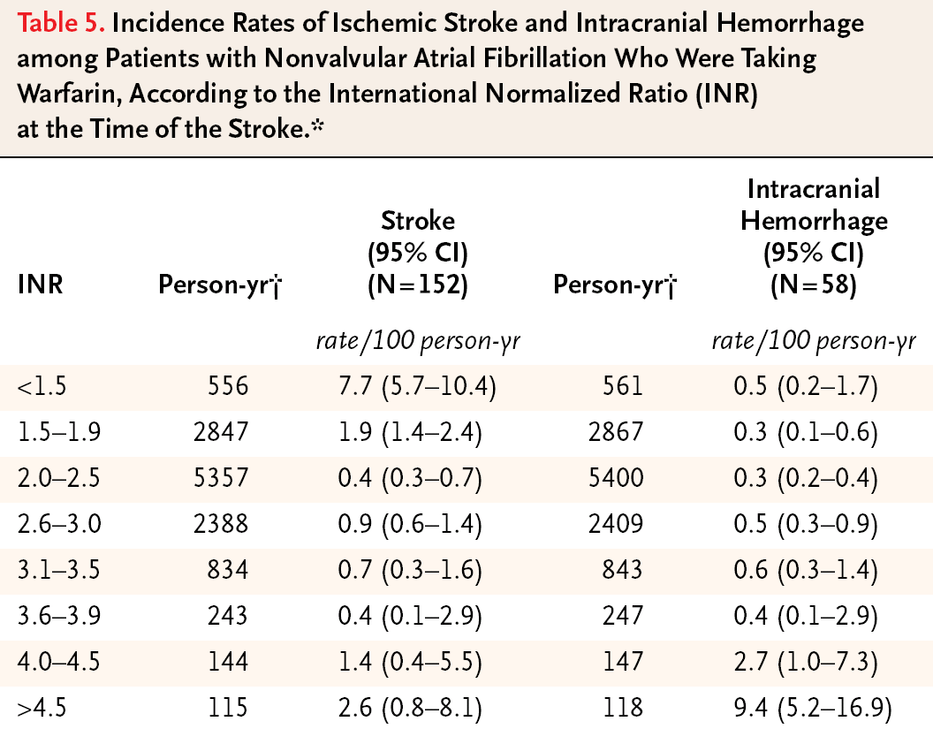
Incidence of stroke and intracranial haemorrhage among
patients taking warfarin
Hylek, EM et al. N Engl J Med. 2003;349:1019-2614
Notes:
29

Slide 30
Direct anticoagulants (DOAC’s)
Dabigatran – (direct thrombin inhibitor)
Non-inferior to warfarin, caution with reduced renal function (CrCl <30ml/min), avoid in advanced liver disease (impaired baseline clotting)
Increased levels with Amiodarone and Verapamil
Half life 12-17 hours (bd preparation). Reversal agent now available
Rivaroxaban – (direct Xa inhibitor)
Non-inferior to warfarin, reduced dose with impaired renal function (CrCl 15-50ml/min)
Half life 5-9 hours (od preparation). No reversal (dialysis)
Apixaban - (direct Xa inhibitor)
Non inferior (or better) than warfarin, can still treat when renal function impaired
Blood levels increased with some antifungals / antibiotics
Half life 8-15 hours (bd preparation). No reversal (dialysis)
Notes:
Dabigatran – CrCl <15ml/min avoid
Caution with Amiodarone and Verpamail, St johns wort and rifampicin
Contraindicated with Ketoconozole, Quinidine
Rivaroxaban – 20mg bd or 15mg od if CrCl 15-49ml/min. Avoid if CrCl <15ml/min
DVT Tx – 15mg bd then 20mg after 3 weeks
Prophylaxis e.g. THR / TKR – 10mg od
Apixaban – levels increased with Ketoconazole / Clarithromycin by reducing the activity of liver enzymes that break down apixaban. Avoid with Phenytoin, st johns wort, rifampacin as blood levels reduced therefore reducing the effectiveness of the drug
DVT / PE Tx – 10mg bd for 7 days then 5mg bd. After 6/12 can reduce to 2.5mg od.
DVT post hip / knee – 2.5mg od starting 12-24 hours post op

Slide 31
SPAF trials versus Warfarin
 | Dabigatran (17-19) | Rivaroxaban (20-21) | Apixaban (22-23)
Study | RE-LY | ROCKET-AF | ARISTOTLE
Design | Probe | Double blind | Double blind
Follow up | 2 years | 1.5 years | 1.5 years
Population size | >18,000 | >14,000 | >18,000
Inclusion | Non-valvular AF + 1 risk factor | Non-valvular AF + 2 risk factors | Non-valvular AF + 1 risk factor
Inclusion (CHADS) | 2.1 | 3.5 | 2.1
Primary endpoint | Stroke and systemic embolism | Stroke and systemic embolism | Stroke and systemic embolism
Warfarin comparator INR control (mean TTR) | 64% | 55% | 62%
Probe – prospective randomised open blinded endpoint

Slide 32
Pharmacokinetics of NOAC’s
 | Apixaban | Dabigatran | Rivaroxaban
Direct factor inhibition | Xa | IIa (thrombin inhibitor) | Xa
Bioavailability | 80% | 6% | 80%
Peak action | 1–3 hr | 1–3 hr | 1–3 hr
Protein binding | 84% | 35% | 92–95%
Renal clearance | 25% | 80% | 33%
Elimination half life with creatinine clearance > 80 ml/min | 15.1 hr | 13.8 hr | 8.3 hr
Elimination half life with creatinine clearance 50–79 ml/min | 14.6 hr | 16.6 hr | 8.7 hr
Elimination half life with creatinine clearance 30–49 ml/min | 17.6 hr | 18.7 hr | 9.0 hr
Elimination half life with creatinine clearance < 30 ml/min | 17.3 hr | 27.5 hr | 9.5 hr
Notes:
Bioavailability – amount of drug available unchanged that reaches the systemic circulation
When given IV = 100%
Protein binding – the less bound a drug is the more efficiently it can traverse the cell membranes or diffuse.
Generally drugs that are less protein bound penetrate tissues better than those highly bound, but are excreted faster.
Can enhance or detract a drugs performance. Look at albumin – a blood protein that drugs bind to.
Renal clearance – excretion of drug into the urine by the kidney

Slide 33
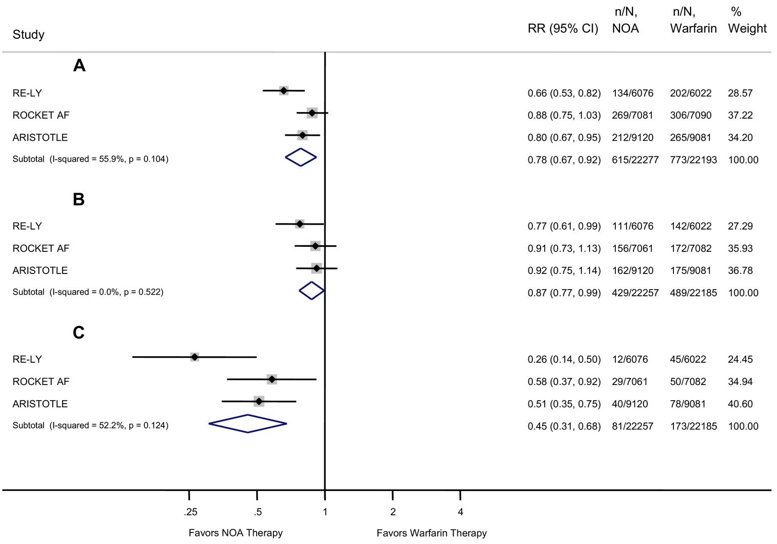
Efficacy and Safety of DOACs vs Warfarin
Notes:
RE-LY (Dabigatran) – 110mg BD = to warfarin in stroke prevention but less bleeding than warfarin
150mg BD – more effective than warfarin in stroke prevention (1.1% per year vs 1.7%) with equivalent bleeding to warfarin
Rivaroxaban – less haemorrhagic stroke than warfarin, similar reduction in ischaemic stroke, less bleeding than warfarin
Apixaban – less haemorrhagic stroke than warfarin, similar reduction in ischaemic stroke, less bleeding than warfarin, lower overall mortality

Slide 34
Decisions…
What would you choose???
Patient established on Warfarin with good INR control and good record of TTR.
Newly diagnosed AF, risk factors for stroke, normal renal function.
Indigestion since starting Dabigatran 150mg bd but ideally needs OAC.
Needs anticoagulation for prevention of DVT / PE post operatively.
Risk factors for thrombo-embolism (score 3, HAS-BLED 2), echocardiogram shows good left ventricular function with mitral valve stenosis.
Post aortic valve surgery with mechanical valve.
Elderly gentleman, head injury sustained from a fall, aortic stenosis.
Male with AF and one risk factor for stroke (hypertension).
Extreme sports, regular skier, needs cardioversion so therefore needs OAC.

Slide 35
Under utilisation of anticoagulation…
Study population: people with AF: aged ≥ 65yrs, not taking warfarin on admission 2001- 2003.
At discharge
- 51% on warfarin
- 49% not on warfarin, 83% of these at high risk
Reasons for non-use of warfarin
- History of haemorrhage (33%)
- Falls (32%)
- Patient refusal/previous non-adherence (14%)
Misunderstanding
Unfamiliarity with evidence and latest guidelines
Getting better! PREFER study (2013) and prolongation study (2015) highlighted ~70% of patients now appropriately anticoagulated for AF
Cost / availability
Hylek et al, Stroke. 2006
Notes:
35
The above study is the first prospective assessment of warfarin prescription at the time of the treatment decision among consecutive patients admitted and discharged with AF. In addition to baseline patient characteristics, we directly determined the reason for not prescribing warfarin for each patient
Most notably, recurrent nonhospitalized falls, previous attempts at warfarin use, recurrent bleeding, patient preference, patient nonadherence, excessive alcohol use, and comfort care status would not be systematically ascertained

Slide 36
Other preparations
Tricagrelor
Antiplatelet
Indicated for prevention of thromboembolic events (MI, stroke) with Acute Coronary Syndrome or MI with ST elevation
Contraindicated in intracranial bleeding, deranged liver function, active bleeding
Bioavailability 36%
Peak concentrations at 1.5 hours
Highly protein bound
Fondaparinex
Direct Xa inhibitor
Chemically related to LMWH (e.g. Clexane)
For treatment of DVT / PE, hip, knee and abdominal surgery
Unstable angina, NSTEMI, STEMI
LMWH
Heparin binds to antithrombin III – inactivates thrombin and factor Xa
LMWH is smaller heparin molecules with only Xa activity but advantageous as more predictable response and monitoring not required

Slide 37
Patient Safety
‘Anticoagulants are one of the classes of medicines most frequently identified as causing preventable harm and admission to hospital’ (NPSA, 2007)
National Patient Safety Goals – January 1st, 2015
Goal 3 Improve the safety of using medications. Reduce the likelihood of harm to
patients and residents associated with the use of anticoagulant therapy.
Anticoagulants frequently appear in the‘ top ten’ of medication incident reports
(NHSGGC, 2010)
Since April 2008 Datix recorded:
73 INCIDENTS relating to warfarin
34 involving to Heparin
13 involving Enoxaparin
8 involving Tinzaparin
NPSA Patient safety alert 18, 28/3/2007.
December 2009. Available at www.mhra.gov.uk
NHSGGC Area drug &Therapeutics Committee, 55,01,2010
Notes:
Was this intracranial Haemorrhage?

Slide 38
Facts or fiction?
Poor anticoagulation control significantly increases ones risk of having a bleed or stroke
Less than ½ of all eligible pts receive appropriate anticoagulation
Patients >75yrs are 3 times less likely to be prescribed warfarin than those <65yrs
Novel agents are licensed for valvular heart disease
Cardioversion can be performed immediately if on a novel anticoagulant
Warfarin and antiplatelets are contraindicated when used in combination
If you are prone to falls, you should not be prescribed anticoagulation
Direct anticoagulants should be stopped 5-7 days before surgery
Fibrin is naturally present in blood
Notes:
In SPAF studies age was a more potent risk factor when combined with other risk factors such as hypertension European heart survey only 67% of eligible af pts are actually receiving warf and those on it long-term are believed to be in TTR only 55% of the time
Despite the ready availability of such clinical guidelines, the under-prescription of warfarin in AF remains commonplace, particularly amongst the elderly and those at highest risk of stroke. Generally, the main concern is of significant haemorrhage or that elderly patients will not be able to manage the complexities of anticoagulation, be it for fear that poor mobility may restrict attendance for therapeutic monitoring, or that dosage changes may be confusing.
Mahmud et al. [15] demonstrate that older patients are three times less likely to be prescribed warfarin. Given that these older patients are, as a consequence of their age, automatically considered high risk for stroke, these data are of concern and must be used to drive the application of stroke risk stratification schema to aid appropriate targeting of anticoagulation.
Marked gender preference, with fewer women receiving anticoagulation. Although males have a preponderance towards developing AF, the reverse appears to be true in relation to stroke risk. For example, the AnTicoagulation and Risk factors In Atrial fibrillation (ATRIA) study has found that AF was more common in men than in women but non-anticoagulated women had a significantly increased annual rate of thromboembolic events over men, even after correction for other stroke risk factors
Fibrin is formed through the clotting cascade – Platelets are naturally present in blood

Slide 39
Questions?
an.hall@health.gov.je
442002 / bleep 121

