Slide 1
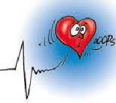
Arrhythmias & Coping
Helen Eftekhari
Arrhythmia Nurse
University Hospitals Coventry & Warwickshire

Slide 2
What’s Normal?
Odd sensations lasting second
Extra beat / jumped
Nighttime heightend sense of awareness
Feeling the apex heart beat
Raised heart rate & short of breath during exercise
Life Event – time to reflect
Life adjustments to changes in health
Anxiety & Depression

Slide 3
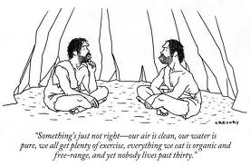
Remember
Modern medicine helps us live longer with health conditions
Medications & treatments have an important role
Aim of treatment is to improve our lives

Slide 4
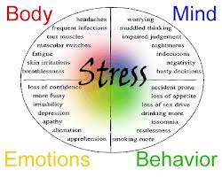
Psychology & Hearts
Relation between heart condition & quality of life mismatch
Coping important
Relation between anxiety & depression with health outcomes

Slide 5
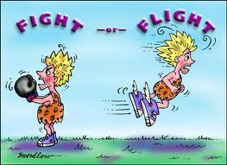
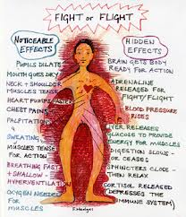
Understanding Anxiety Fight & Flight

Slide 7
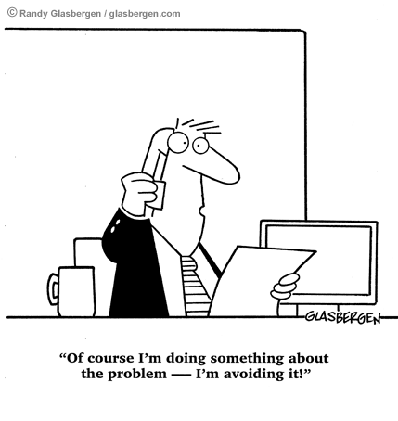
Avoidance Behaviours
Maintains locus of control
Avoid activity / situation believed responsible for unpleasantness
Exercise avoidance common
Spreading of avoidances detrimental
Catastrophizing

Slide 8
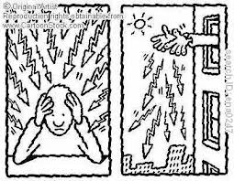
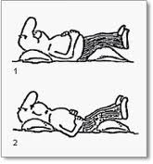
Basic Coping Strategies
Recognise triggers
Reasoning
Distraction
No hypervigilance
Diaphragmatic Breathing
Relaxation techniques
Goal setting
Gradual Exposure
Expert help if persists

Slide 9
Enjoy Life
Pace yourself – Be realistic
Listen to those around us
Give & Take
Exercise Regularly
Support Groups –Your not alone

